Slide 1

More Data? More Problems?
Andrew Moll
Technical Evangelist | @AskTheData | www.AndrewSMoll
Andrew.Moll@Microsoft.com

Slide 2



Slide 3
Hadoop is a platform with portfolio of projects
Governed by Apache Software Foundation (ASF)
Comprises core services of MapReduce, HDFS, and YARN
In addition to the core, includes functions across:
Data services which allow you to manipulate and move data (Hive, HBase, Pig, Flume, Sqoop)
Operational services which help manage the cluster (Ambari, Falcon, and Oozie)
Governance and integration
Data access
Security
Operations
Data workflow, lifecycle and governance
Falcon
Sqoop
Flume
NFS
WebHDFS
Batch
Map reduce
Script
Pig
SQL
Hive/Tez, HCatalog
Nosql
Hbase
Accumulo
Stream
Storm
Search
Solr
Others
Spark, in-memory,
ISV engines
Authentication
Authorization
Accounting
Data protection
Storage: HDFS
Resources: YARN
Access: Hive, …
Pipeline: Falcon
Cluster: Knox
Provision, manage, and monitor
Ambari
Zookeeper
YARN: data operating system
HDFS (Hadoop Distributed File System)
1
°
°
°
°
°
°
°
°
°
°
Scheduling
Oozie
°
°
°
°
°
°
°
°
°
°
°
°
°
°
°
°
°
°
°
N
Data management

Slide 4

















With many contributors
80 committers to Hadoop core project
Notes:
http://hadoop.apache.org/who.html

Slide 5

Windows Azure HDInsight
Where Big Data Meets the Cloud
100% Apache Hadoop solution in the cloud
Insights through Excel
Deployment agility
Hadoop with Enterprise security and manageability
Develop in .NET and Java
Built on Hortonworks Data Platform (HDP)
Get Started with HDInsight: http://tinyurl.com/hdinsight
Notes:
OPTIONAL SLIDE: Use if you need to go deeper into the product
To go a bit deeper on two of the investments I just talked about – I want to talk a little about the Windows Azure HDInsight Service, which is our Hadoop-based service that brings a 100% Apache Hadoop solution to the cloud.
HDInsight gives you the ability to gain the full value of Big Data with a modern, cloud-based data platform that manages data of any type, whether structured or unstructured, and of any size.
With HDInsight you can seamlessly store and process data of all types through Microsoft’s data platform. You can analyze your Hadoop data with PowerPivot, Power View and other Microsoft BI tools, thanks to integration with Microsoft data platform.
Simplicity of Windows Azure: HDInsight enables simple and straightforward installation of your Hadoop clusters. You can accelerate the deployment with the cloud by deploying a Hadoop cluster on Windows Azure in instead of days or weeks. Use simple web-based tools and APIs to interact with and monitor your cluster.
Seamless scale and elasticity: HDInsight allows you to quickly create a Hadoop cluster scaled to fit your demand, when you need it, run your analysis, and shut down the cluster when you are done – leading to cost savings only possible on a cloud environment.
Connect to MS BI tools: Through the Hive Open Database Connectivity (ODBC) Driver you can now glean insights on all your data with familiar tools Excel. In addition, you analyze all your data easily with BI tools like Microsoft SQL Server Analysis Services (SSAS), PowerPivot, and Power View.

Slide 6

HDFS
HDFS is a distributed file system
From a few nodes to thousands of nodes
Files can be spread out over multiple nodes
HDFS stores large amounts of data
Very large files are supported including those larger than the capacity of a single node
HDFS stores non-relational files
Server
Server
Files
Server
Server

Slide 7

MapReduce
Takes processing to where data is
Distributed processing: instead of serializing processing through one pipe, distributes computing locally where data is
Brings back only the resultant data
Scales linearly as you add nodes
Three-step execution
Map: Developer writes map functions to the data
Shuffle / Distributes: Framework automatically shuffles for you (networking, synchronization, recovery, scheduling)
Reduce: Developer writes reduce functions to bring resultant data back
Input Domain
// Map Reduce function in JavaScript
var map = function (key, value, context) {
var words = value.split(/[^a-zA-Z]/);
for (var i = 0; i < words.length; i++) {
if (words[i] !== "")
context.write(words[i].toLowerCase(),
1);}
}};
var reduce = function (key, values, context) {
var sum = 0;
while (values.hasNext()) {
sum += parseInt(values.next());
}
context.write(key, sum);
};
Map
Map
Map
Shuffle
Shuffle
Shuffle
Reduce
Reduce
Reduce
Shuffle
Reduce
Output domain

Slide 8

Hive
SQL-like queries on Hadoop data in HDFS
HiveQL is a SQL-like language (subset of SQL)
Hive structures include well-understood database concepts such as tables, rows, columns, partitions
Compiled into MapReduce jobs that are executed on Hadoop
Dramatic performance gains with Stinger/Tez
Stinger is a Microsoft, Hortonworks and OSS driven initiative to bring interactive queries with Hive
Brings query execution engine technology from Microsoft SQL Server to Hive
Performance gains up to 100x
Microsoft contribution to Apache code
TPC-DS Query 27– 1 TB of Data
1400s
32x Speedup
44.3s
40X
Speedup
35.1s
Hive 10
HDP 1.3 / Hive 11
HDP 2.0
Hadoop 2.0

Slide 9


Slide 10
Monitor a Hadoop Cluster
Ambari provides a dashboard for monitoring health and status of the Hadoop cluster.
REST Based API
Puppet for process control
Ambari leverages Ganglia for metrics collection.
Ambari leverages Nagios for system alerting and will send emails when your attention is needed (e.g., a node goes down, remaining disk space is low, etc).
Notes:
Puppet/modules all the friends

Slide 11

But… Don’t you manage my clusters?????
Yes, We mange Cluster up-time, HA, DR, etc.
We don’t manage how you use it…
@AskTheData

Slide 12
Demo

Slide 13
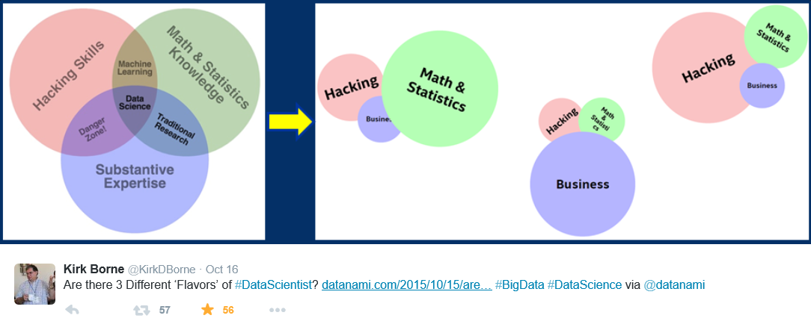
What is Data Science?

Slide 14

Who is a Data Scientist?
Data Scientist
Notes:
https://headsink.files.wordpress.com/2012/03/hipster.jpg

Slide 15

Nate Silver
Notes:
Is data science a sexy term for statistician,
AKA Nate Silver

Slide 16


Slide 17
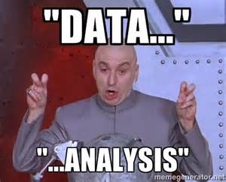

Slide 18
Advanced Analytics
How can we make it happen?
Prescriptive Analytics
What will happen?
Predictive Analytics
OPTIMIZATION
FORESIGHT
Why did it happen?
VALUE
Diagnostic Analytics
What happened?
INSIGHT
Descriptive Analytics
INFORMATION
Traditional BI
Advanced Analytics
Source: Gartner
DIFFICULTY
Notes:
First let’s start by level setting what we mean by Advanced Analytics. We often get asked whether Advanced Analytics is just “BI” with fancier branding. This chart helps to illustrate why that is not the case.
Put simply, BI is a tool that is designed to show you what has happened so you can make your own decisions about what to do next. The next level – Advanced Analytics – allows you to take that data to the next level by having the computer predict what will happen next. This is more accurate than a human can ever hope to be, as the computer can reason over far more variables than a human can on a BI dashboard. But predictive is only the first step, the next step is once you are accurately predicting the future you can program the computer further to anticipate those occurrences and react accordingly.

Slide 19

Microsoft & Machine Learning Answering questions with experience
1991
1997
2008
2009
2010
2014
2014
Microsoft Research formed
Hotmail launches
Which email is junk?
Bing maps launches
What’s the best way home?
Bing search launches
Which searches are most relevant?
Kinect launches
What does that motion “mean”?
Skype Translator launches
What is that person saying?
Azure Machine Learning launches
What will happen next?
Machine learning is pervasive throughout Microsoft products.
“
John Platt, Distinguished scientist at Microsoft Research
”
Notes:
Microsoft has been working on machine learning for over two decades. We formed Microsoft research back in 1991 to tackle the tough problems internally that we’re enabling you to tackle yourselves today.
When we think of learning from experience – past data + human input – a great example is Hotmail. Back in 1997, external email was a relatively new concept. There wasn’t a lot to go on in terms of what email the customer wants and what they do not. With the rise of email, also came spam – and lots of it. Some of those issues were easy – like Nigerian princes we learned pretty quickly don’t give away their fortunes to strangers. But what about “free offer” – maybe that free offer is something the customer always wanted. Maybe it’s something they’d never want. But that’s where the “human input” part comes in as data is being collected – that takes the form of the actual user of the email service saying “yes, this is junk” or “no, I want this” and then the data scientist learning in aggregate and making tweaks to the underlying model in response.
And we kept going with that learning – relying on past data and human input to solve problems like the best way home, which search results are most meaningful to the user and one of the toughest ones to tackle with Kinect. Kinect’s past data was all in the lab – we didn’t have a product in market that captured user input and translated that to active game play so we had to make up the variables. But that only takes us so far. The researchers told me that one thing they didn’t consider was people answering the phone while playing. This happens a lot – and Kinect at first was translating this as a wild motion in the game play – essentially crashing people’s cars or any number of unintended consequences. That was the human input we rely on, which allowed us to learn quickly and adjust the underlying model to ensure that answering the phone would not be considered part of the game moving forward.
Skype translator is another huge machine learning problem to solve if you think of all the ways a person who is speaking English can pronounce the same word – tom-A-to or tom-AH-to – that’s the same word in French so Skype has to adjust quickly to ensure all the millions of variables are considered.
But what about using all this learning to predict what’s next? Many of the same algorithms running behind the scenes of our products in market today are available within Azure ML, allowing you to take your own past data and learn from it what will happen in the future for your business.

Slide 20
Current State of the Business No improvement in generations
Expensive
Huge set-up costs of tools, expertise, and compute/storage capacity create unnecessary barriers to entry
The Cloud Changes the Landscape
Siloed data
Siloed and cumbersome data management restricts access to data
Disconnected tools
Complex and fragmented tools limit
participation in exploring data and
building models
Deployment complexity
Many models never achieve business
value due to difficulties with deploying
to production
Notes:
I mentioned earlier that data science and machine learning have been around a long time. This begs the question as to why it’s not being used more broadly. Essentially until now, this technology has been restricted to those with deep knowledge and deep pockets, available only to a specialized or well funded few.
Frankly, this work has been expensive. Our competitors are charging $100,000 a site license just to walk up to this solution, which doesn’t even speak to the time and cost to actually implement.
Second, the data management side is really cumbersome – in many cases we see the folks who are doing the data science work sitting in their own department – finance, operations, marketing – with access only to their siloed data and zero connection to the data sources they need in the greater organization.
Third, even if they have access to the data, they’re still often working in a vacuum on languages like R that are completely unfamiliar to the rest of the development team.
Lastly, if they are able to solve all of these challenges, they then reach a roadblock actually putting their model into production, with models either becoming stale as they wait to be deployed or growing stale in production because the process to get them there was too time consuming to repeat.
But now there is a solution to all this. How? The Cloud. The Cloud changes the game.

Slide 21
Demo

Slide 22
Summary
Cloud Trends
Azure Overview
Azure Resource Manager
Microsoft and Containers
Big Data Big Problems

Slide 23
Other cool things Microsoft is doing

Slide 24

How-old.net

Slide 25

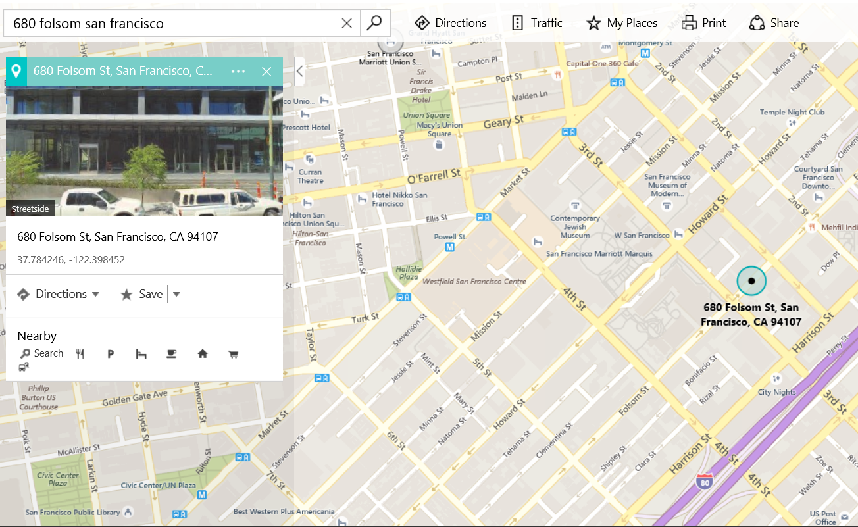

Microsoft Reactor
http://microsoftreactor.com/

Slide 26



